Slide 1

HAVE YOU EVER IMAGINED A LIFE WITHOUT LIMITS?

Slide 2
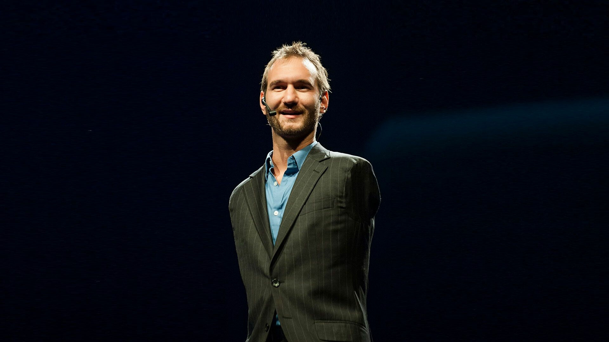




NICK VUJICIC
“IF YOU CAN'T GET A MIRACLE, BECOME ONE”

Slide 3
CONTENT
01
04
EARLY LIFE
CHALLENGES
02
05
PRESENT LIFE
CONCLUSION
03
PROJECTS & PUBLICATIONS

Slide 4
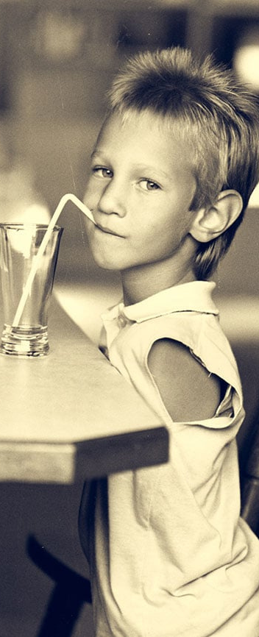
EARLY LIFE OF NICK VUJICIC
  Nick Vujicic was born on December 4, 1982, in Melbourne, Australia.
  Nick was born with a rare condition known as phocomelia, which is characterized by the absence of limbs.
  Family supported Nick with adaptations for easier life with disability.
  Nick faced challenges in mainstream school, overcoming bullying and discrimination.

Slide 5
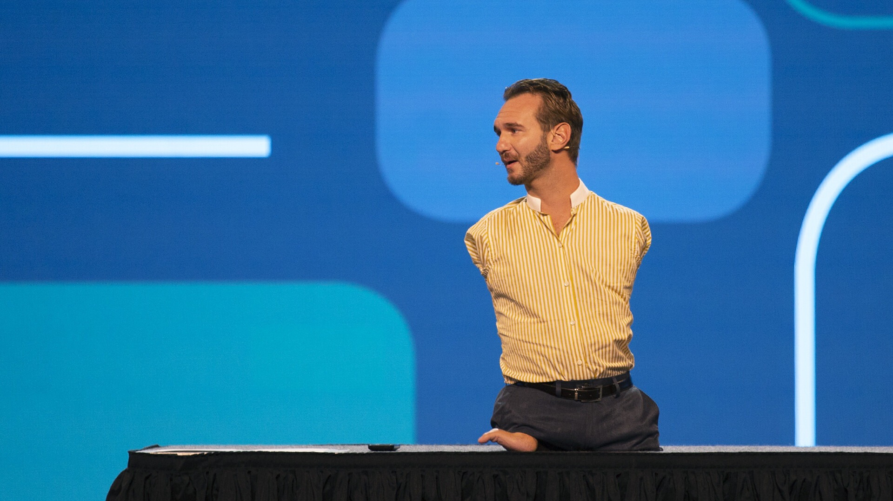
PRESENT LIFE OF NICK VUJICIC
Motivational Speaker
Vujicic travels extensively around the globe, delivering inspiring speeches to audiences of all ages and backgrounds.
Writer
Vujicic is a prolific author, having penned several books that have touched the lives of millions worldwide.
Actor
Vujicic has ventured into the world of acting, appearing in several short films and a few television shows.
Entrepreneur
Vujicic is not only a motivational speaker and author but also a successful entrepreneur.

Slide 6



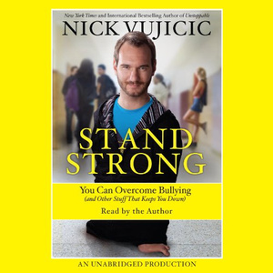

PROJECTS
  Project 1
  Project 2
  Project 3
LIFE WITHOUT LIMBS
ATTITUDE IS ALTITUDE
STAND STRONG USA
Founder and CEO
Mission: Sharing the message of hope, love, and faith globally
Founder
Goal: Motivating individuals to overcome challenges
Involvement in the anti-bullying campaign
Focus on building resilience.

Slide 7
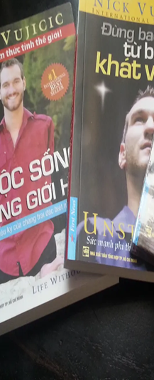
PUBLICATIONS
“Life without Limits (2010)”
Nick’s first book sharing his story and principles
“Unstoppable (2012)”
Discussion on the role of faith in overcoming obstacles
“Love without Limits (2014)”
Co-authored with wife kanae Vujicic sharing their love story and challenges
“Be The Hands and Feet (2018)”
Encouraging readers to actively show love and compassion

Slide 8
CHALLENGES
Physical limitations
Born limbless, Nick Vujicic adapts with devices, showcasing resilience, inspiring others to overcome challenges with a positive mindset.
School harassment
Nick Vujicic faced school harassment due to his physical differences. Overcoming adversity, he now advocates against bullying, promoting inclusivity.
Emotional Struggle
Nick Vujicic, impacted by bullying and misconceptions, emphasizes emotional well-being, resilience, and a positive mindset for overcoming challenges.
Loneliness and suicide thoughts
In adolescence, Nick Vujicic faced loneliness and suicidal thoughts, highlighting the vital role of mental health and resilience in his journey.

Slide 9
CONCLUSION
LIFE WITHOUT LIMBS

Slide 10
REFERENCES
Home (2023) Nick Vujicic. Available at: https://nickvujicic.com/ (Accessed: 14 November 2023).
Inspirational story of Nick Vujicic to warmly move you (2017) Author Voices. Available at: https://authorvoices.com/inspirational-writing/inspirational-story-nick-vujicic-warmly-move/ (Accessed: 15 November 2023).
Michael (2023) 11 inspiring facts about Nick Vujicic, Facts.net. Available at: https://facts.net/nick-vujicic-facts/ (Accessed: 14 November 2023).
Nick Vujicic (2023) Wikipedia. Available at: https://en.wikipedia.org/wiki/Nick_Vujicic (Accessed: 15 November 2023).

Slide 11

ANY QUESTIONS!?

Slide 12

OUR TEAM
Pujana Rathnayaka
20222362
Mohomad Huzrin
20222269
Nuran Chandrasekara
20221926
Jithnuka Athurugiriya
20222123
Saad Mazhar
20221804

Slide 13
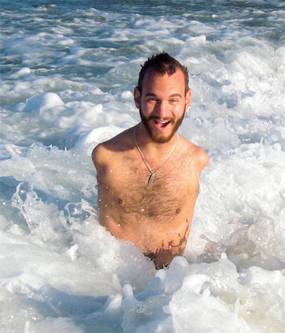
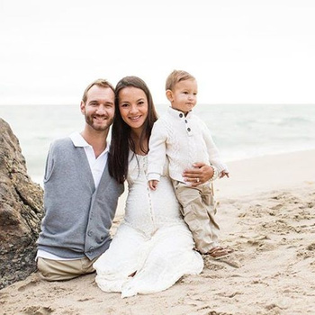
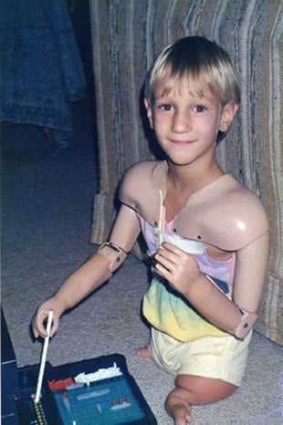
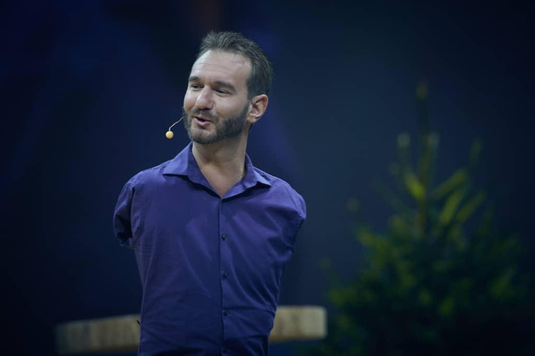


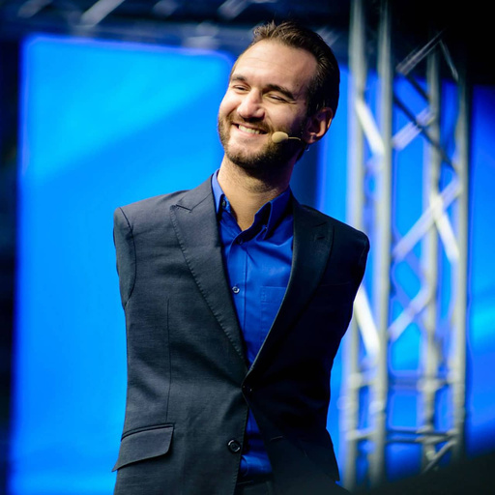
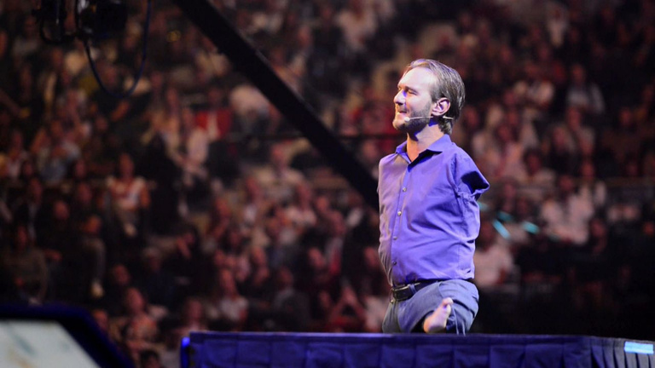
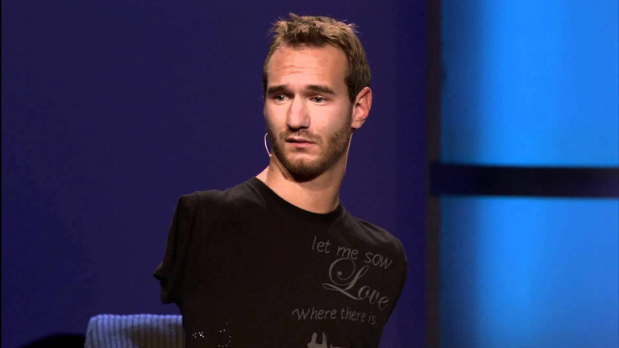
THANK YOU

